Slide 1



ONLINE COMPLAINT REGISTRATION
AND
MANAGEMENT
SYSTEM

Slide 2
TEAM MEMBERS:
SIVARANJINI. S- 310821104091
SURESHKUMAR.B- 310821104096
VISHAL ESHWAR.D-310821104115
NITYA POOJAA. T- 310821104065

Slide 3
INTRODUCTION:
An online complaint registration and management system is a software application or platform that allows individuals or organizations to submit and track complaints or issues they have encountered.
Hardware used is Windows machine.
Software used are two web browser.
System used are Bandwidth of 30mbps.

Slide 4
Project Overview:
PURPOSE :
It can help optimize the complaint handling process and empower organizations to develop a safety management system to efficiently resolve customer complaints, while staying in line with industry guidelines and regulatory compliance obligations.
It provides a centralized platform for managing complaints, streamlining the complaint resolution process, and improving customer satisfaction.

Slide 5
PROJECT OVERVIEW :
KEY OBJECTIVES :
User registration
Complaint submission
Tracking and notifications
User can interact with the agent who has assigned the complaint.
Assigning and routing complaints
Security and confidentiality

Slide 6
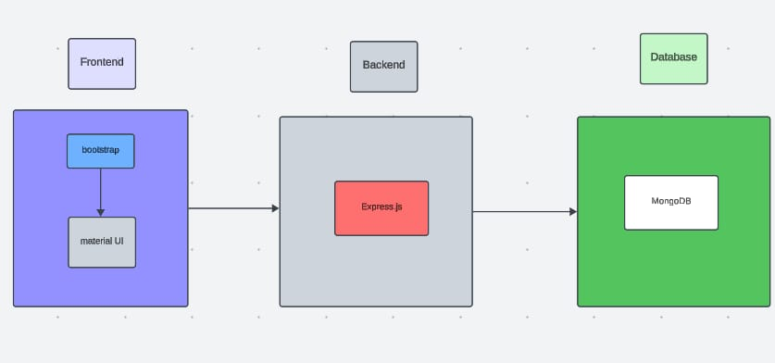
ARCHITECTURE :

Slide 7
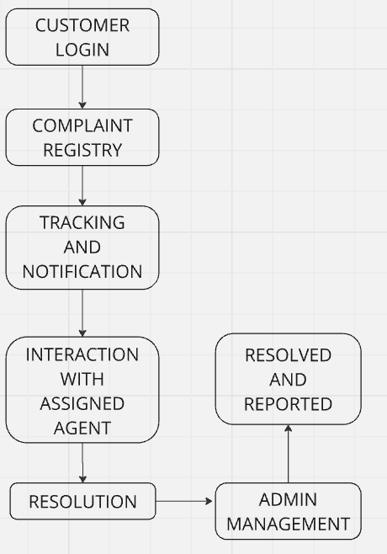
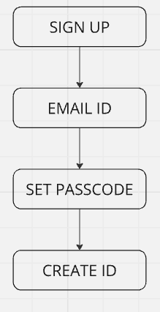
FLOWCHART :
New User : Login :

Slide 8
FRONTEND :
Frontend serves as the client.
The frontend utilizes the bootstrap and material UI library to establish real-time and better UI experience for any user whether it is agent, admin or ordinary user working on it.
The frontend encompasses not only the user interface and presentation but also incorporates the axios library to connect with backend easily by using RESTful Apis.

Slide 9
BACKEND AND DATABASE :
On the backend side, we employ Express.js frameworks to handle the server-side logic and communication.
For data storage and retrieval, our backend relies on MongoDB. MongoDB allows for efficient and scalable storage of user data, including user profiles, for complaints registration, etc. It ensures reliable and quick access to the necessary information during registration of user or any complaints.

Slide 10
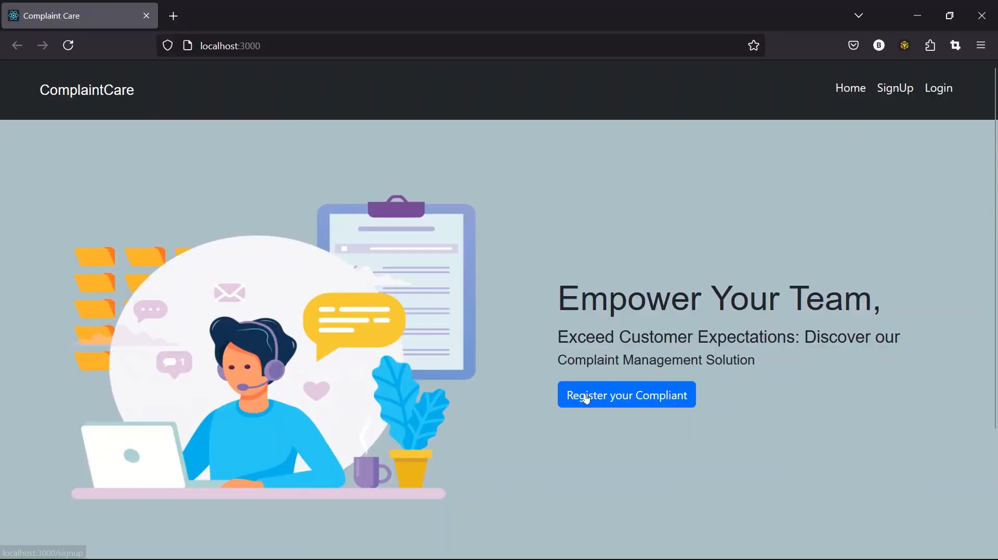
OUTPUT :

Slide 11
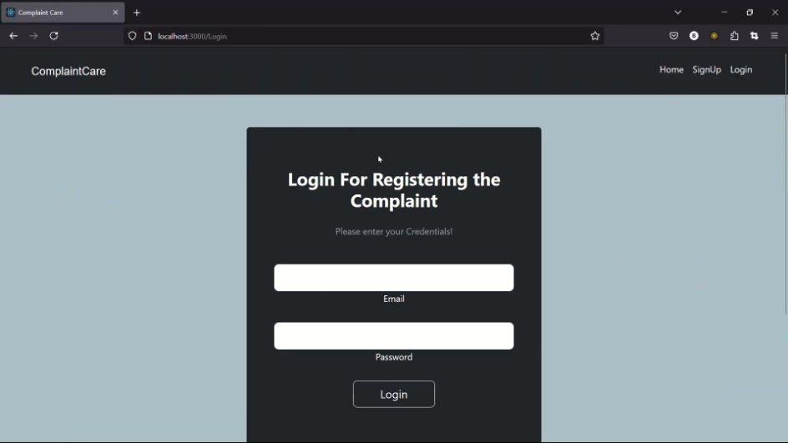
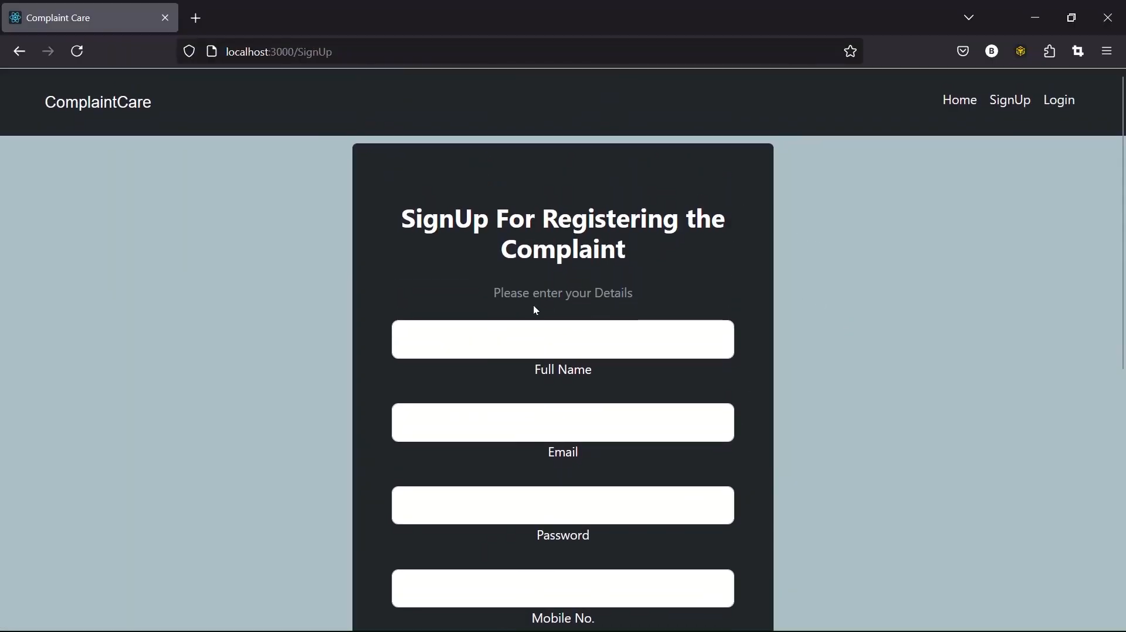
OUTPUT :

Slide 12
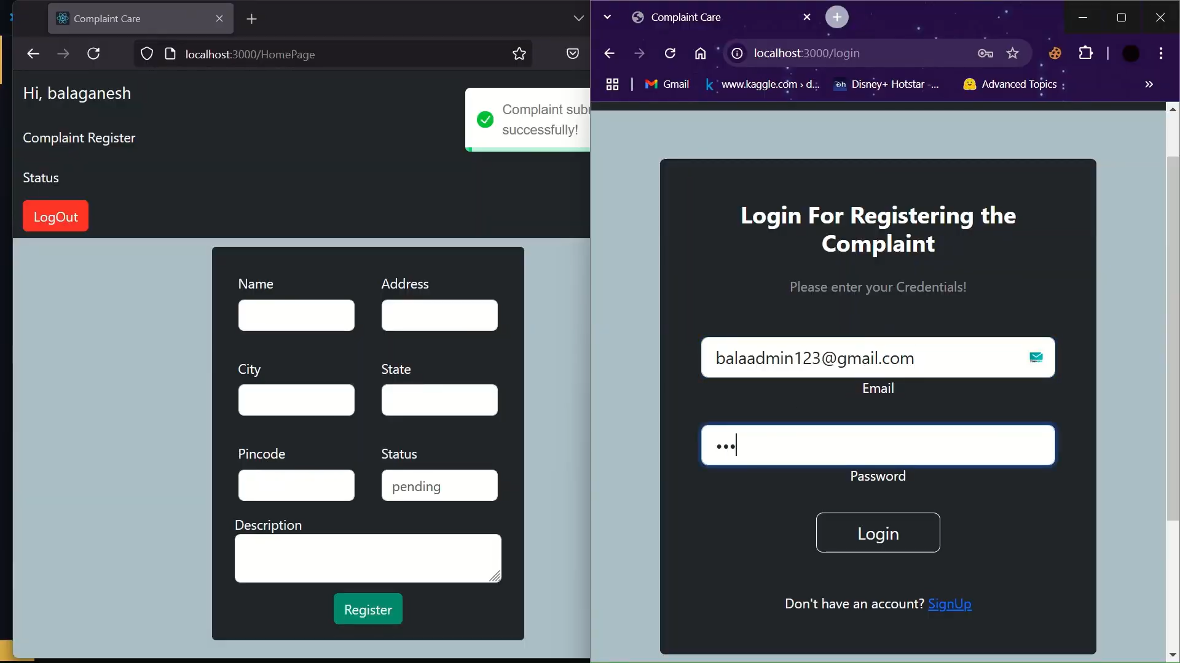
OUTPUT :

Slide 13
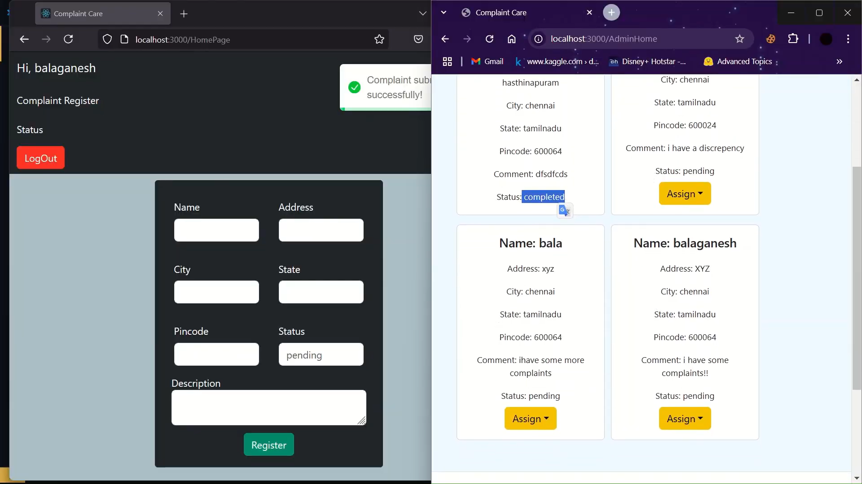
OUTPUT :

Slide 14
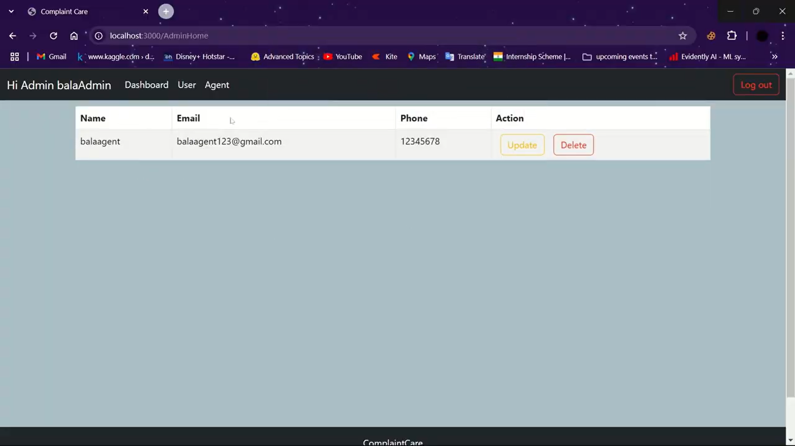
OUTPUT :

Slide 15
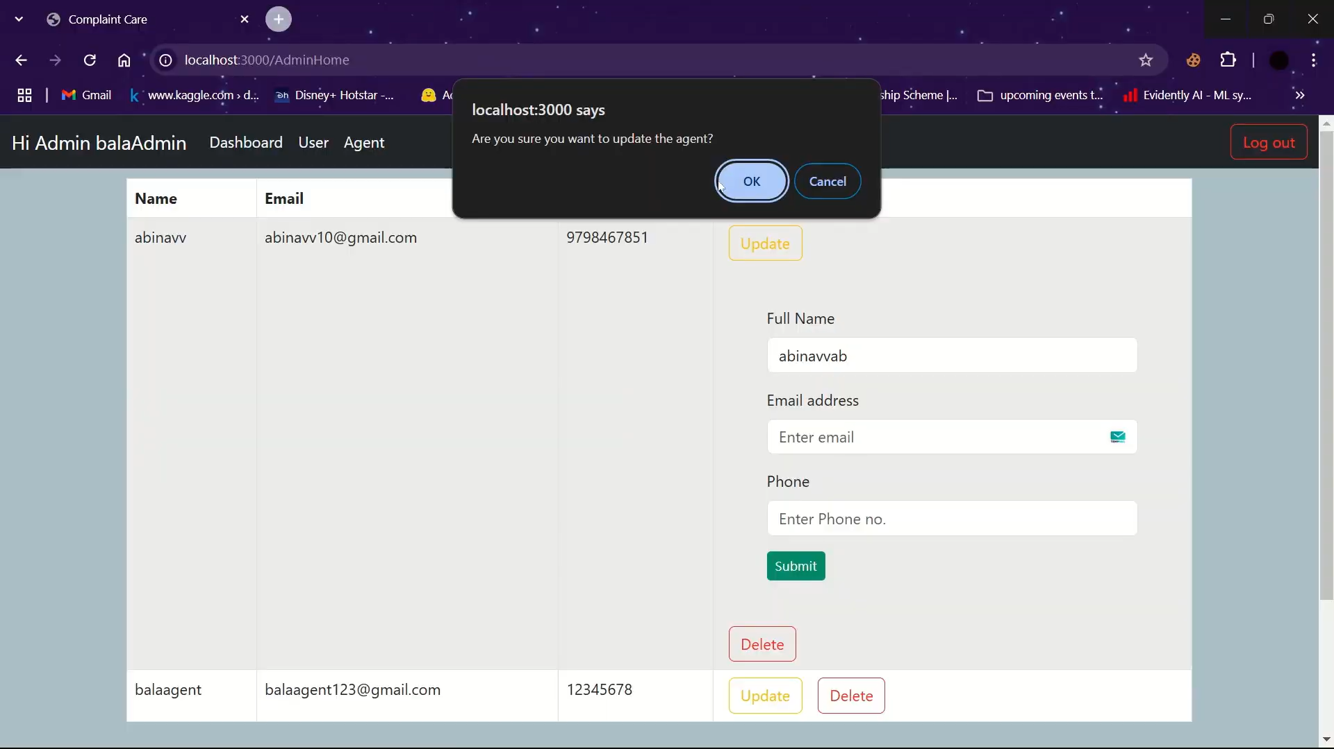
OUTPUT :

Slide 16

THANK YOU :

